Slide 1
Value Driver Tree Practice for Logistics Co.
You have the following problem statement – how would you create an Issue Tree for Logistics Co.?
How can we reduce the number of returned shipment items by at least 25% (184) through reductions in either Premium or Non-Premium shipping modes costs by 31st December 2022?
Previously you helped build out an Issue Tree that showcases how the different issues are all connected using the opposite words technique.
Value driver trees are a useful tool to help prioritize which issues should be tackled as a priority through quantifying which issues have the largest strategic business value
In industry, not all issues are equally prioritized; value driver trees help focus where our attention should be placed.
Using the table of values in the following slides, assign values to each of your issues to help identify which issue should be our immediate priority. Good luck!

Slide 2
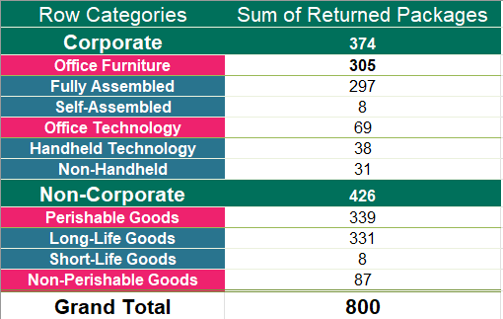
Value Driver Tree Practice for Logistics Co.
In the previous exercise, you’ve crafted your issue tree. We now have a series of enquiries we can take to help size up our analysis.
How can we reduce the number of returned shipment items by at least 25% (184) through reductions in either Premium or Non-Premium shipping modes costs by 31st December 2022?
It’s now time to populate our issue tree so we can definitively focus on the issues that contribute the most towards returned items!
Below is a table that summarizes some initial statistics that you, and the team, have pulled together for your analysis based off the issue tree that has been outlined.
Use this data to fill in the blanks in your value driver tree so you’ll know which areas you should focus your attention on the most for your detailed analysis!
How to interpret this table
When analyzing the data here, note this is grouped together by category and sub-category.
For example, Corporate Packages, composed of 374 returned packages, it itself made up of:
  305 Returned Packages coded to Office Furniture
  The 305, is itself composed of 297 Returned Packages from Fully Assembled, and 8 Self-Assembled

Slide 3
Value Driver Tree Practice for Logistics Co.
Fill in the blanks with the relevant value for each issue that have been provided to you by your team. As an analyst, it’s important that you’re comfortable structuring an analytical approach to business problems and quantifying the value associated with issues.
Customer Type
Primary Product Category
Secondary Product Category
Fully Assembled
Office Furniture
297
305
Self-Assembled
Corporate
8
Handheld Technology
How can we reduce the number of returned shipment items by at least 25% (184) through reductions in either Premium or Non-Premium shipping mode returns by 31st December 2022?
374
Office Technology
38
69
Non-Handheld
31
Long Life Goods
Perishable Goods
331
Non-Corporate
339
Short Life Goods
426
Non-Perishable Goods
8
87

